Slide 1
Events
Notes:
Purpose: To introduce handling of simple mouse and keyboard input.
Learning Objective
By the end of this tutorial, children should be able to:
• Understand that programs can respond to input from various events, including from mouse buttons and keyboard keys.
• Understand that events can happen multiple times within one program.
• Understand that different events can run within the same program.
• Write simple programs that respond to mouse and keyboard events.

Slide 2
Event
Input
Output
Notes:
Introduce students to key vocabulary for this lesson:
Event (see next slide)
Input is data sent to a computer system from devices such as a keyboard, mouse, microphone, camera or physical sensor. Input devices enable information from the outside world to get into a computer – without them, we wouldn’t even be able to switch the computer on! Some are built in; others are plugged in or wirelessly connected.
Output is data or information communicated from a computer system to the outside world via various devices.

Slide 3
In computing, an event is an action or occurrence recognised by software,
Notes:
In computing, an event is an action or occurrence recognised by software,

Slide 4
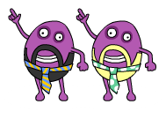
Notes:
Introduce Code Disco (from BusyThings):
Children should be encouraged to try running their programs to see what happens. They should not always expect to get it right first time. Testing a program, seeing what goes wrong and then fixing the problem is a very important part of coding. Tutorials and challenges in Code Disco always build on what has been learned previously. Children should be encouraged to think about what they've just learned, and see how it can be adapted and extended to solve other problems. Breaking a problem down into simpler problems and then combining the solutions is a very useful strategy in coding.

Slide 5
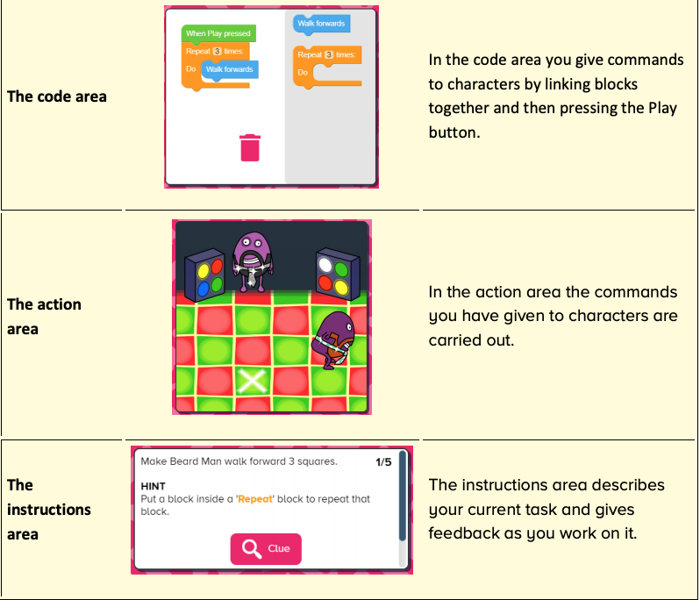
Notes:
Introduce students to Busy Code:
Code Area
Action Area
Instruction Area

Slide 6
Notes:
Show students the event blocks found within Busy Code.

Slide 7
Notes:
Tutorials (10/15mins)
Tutorials consist of multiple steps that can be worked through.
The objective will be presented in the instruction area in the bottom left of the screen, along with any hints that may help children to complete the stage. Some steps include a clue button which will give a visual clue, normally where a new block type is introduced or an existing block type is used in a new way.
Once each stage is complete, a next button will appear allowing children to move onto the next stage.
Once the final stage has been completed, children can either try any related challenges or projects or can move onto the next tutorial.
You will want to demo this with your students going thought the first instructions together.

Slide 8
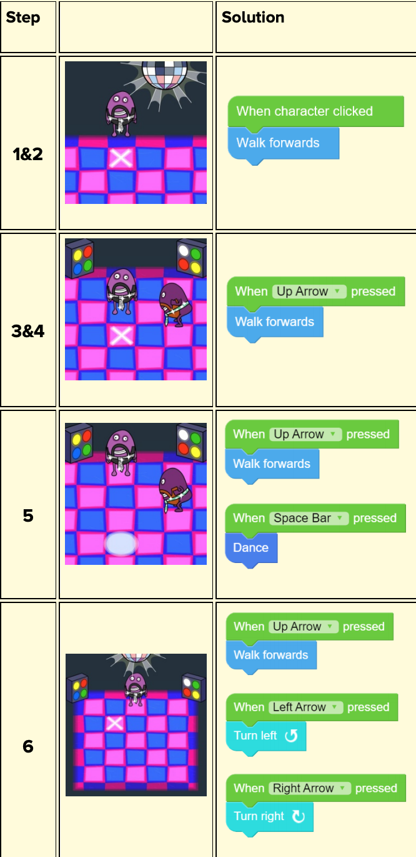
Notes:
Tutorial 4 solutions - please note that while the solutions are correct, children will still need to click the character/press keys appropriately to complete the task.

Slide 9
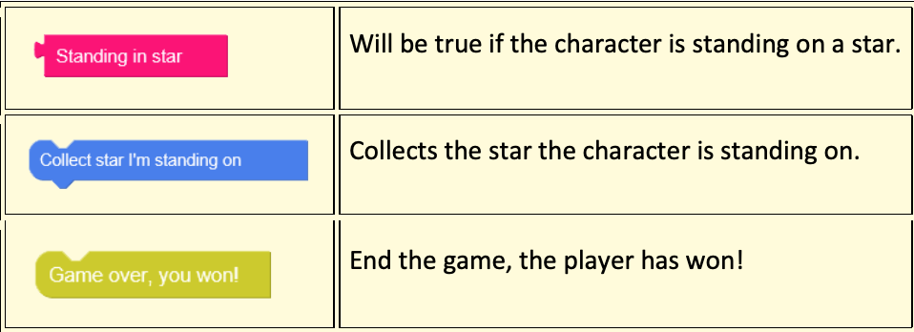
Notes:
Project (10/15mins)
Collect stars 1
Objective: Start making a simple game. Add commands to make the character walk around, and if he stands on a star, collect it.
Project resources are open-ended tasks that give children the chance to be creative with what they have learned so far. Each project is concentrated on a specific theme and only provides the relevant blocks/characters/props to work within that theme.
There are no correct answers and children should be encouraged to experiment. Projects are often provided in multiple versions, so children can revisit a similar idea once they have learned more and elaborate on their previous ideas.
Projects can be saved.

Slide 10
Notes:
Extend Project 1 (10 mins)
Collect stars 2
Extend the game created in part 1 by completing part 2. Add multiple stars to be collected and signal the end of the game when all have been collected. Randomise the layout, so it's different each time.
Project resources are open-ended tasks that give children the chance to be creative with what they have learned so far. Each project is concentrated on a specific theme and only provides the relevant blocks/characters/props to work within that theme. There are no correct answers and children should be encouraged to experiment.
Projects are often provided in multiple versions, so children can revisit a similar idea once they have learned more and elaborate on their previous ideas.
Projects can be saved.

Slide 11
Notes:
Extend Project 2 (10 mins)
Collect stars 3
Continue to use the game created in part 2. Check if the player has stepped in a puddle and if so, lose the game.
Project resources are open-ended tasks that give children the chance to be creative with what they have learned so far. Each project is concentrated on a specific theme and only provides the relevant blocks/characters/props to work within that theme. There are no correct answers and children should be encouraged to experiment.
Projects are often provided in multiple versions, so children can revisit a similar idea once they have learned more and elaborate on their previous ideas.
Projects can be saved.

